Slide 1
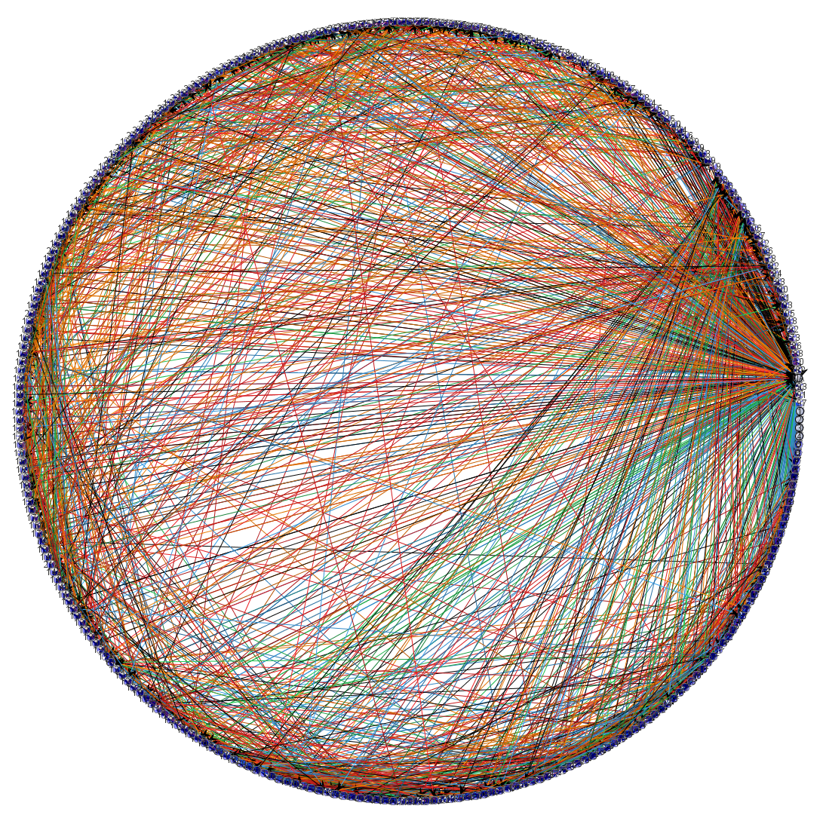
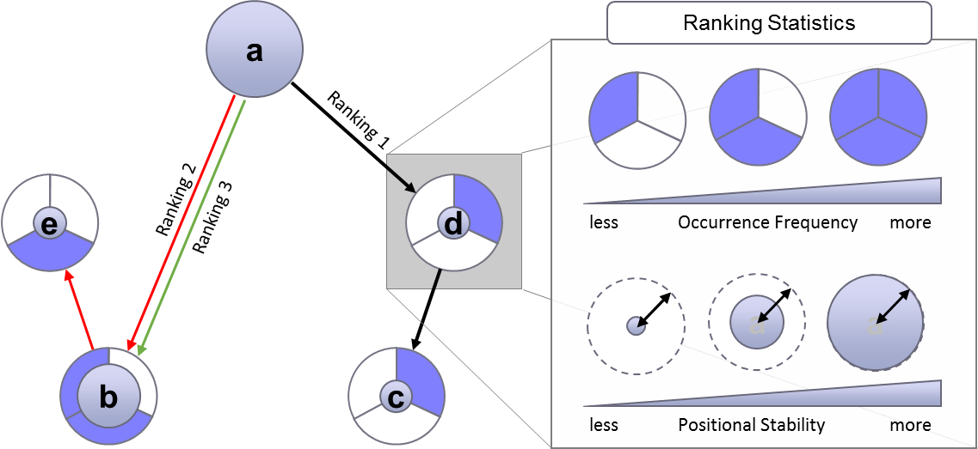

Slide 2
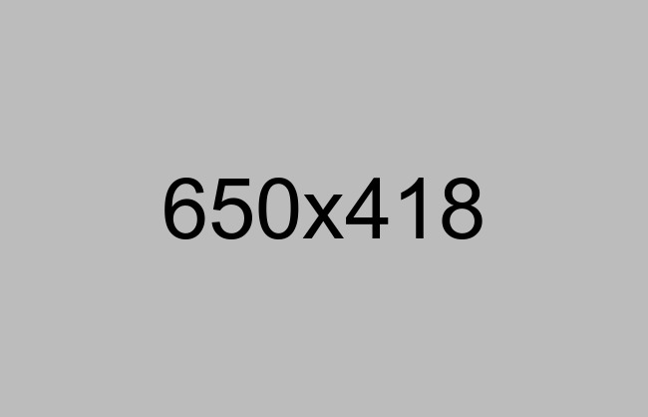

Slide 3

Matrix Analysis

Slide 4
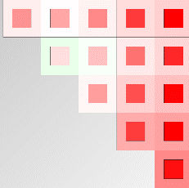
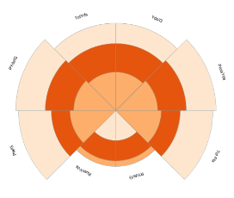
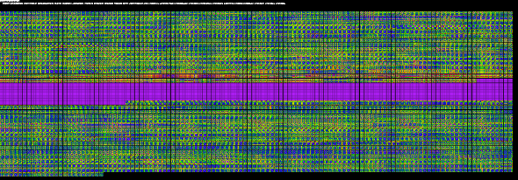

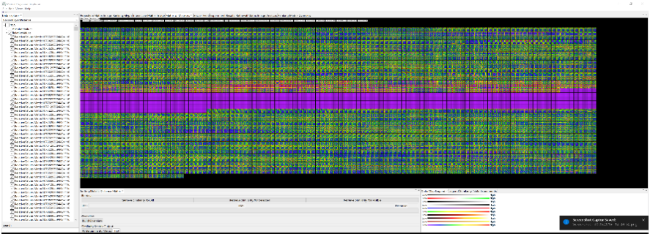
a
e
d
b
c
Matrix Analysis

Slide 5
Matrix Analysis

Slide 6
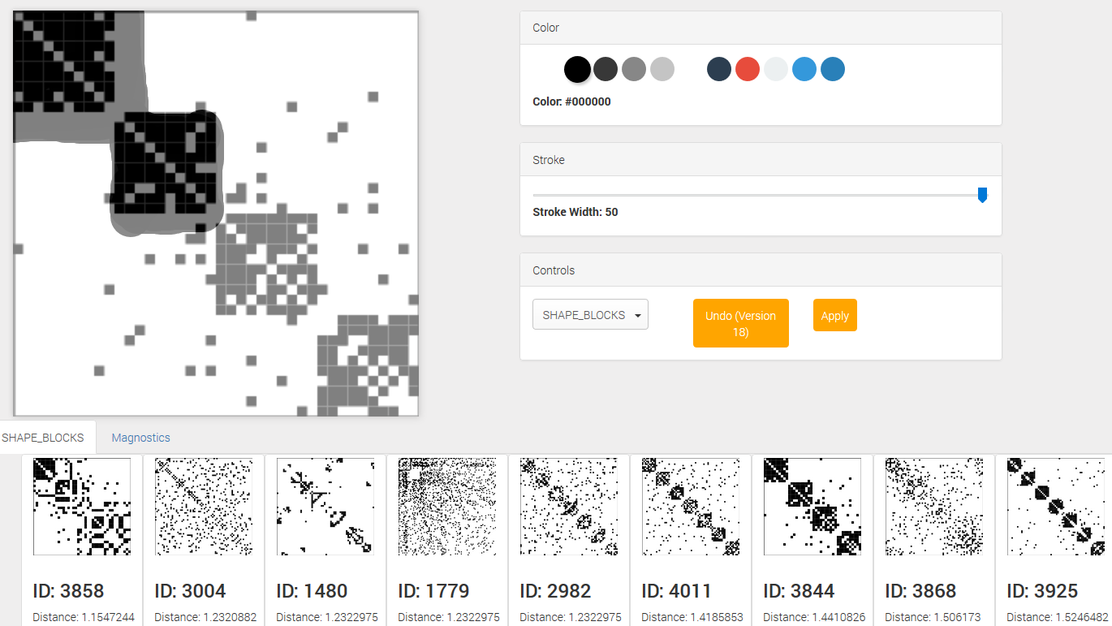
project-sketching.png
Sketching

Slide 7
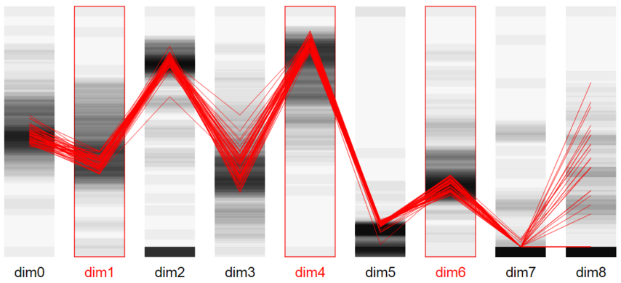
project-subspace.png
Subspace Analysis

Slide 8

Engineered Features
Magnostics
Pattern Analysis
Learned Features
Convolutional Neural Network
…

Slide 9
Pattern Analysis
…

Slide 10

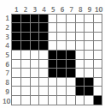
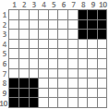
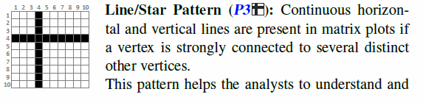
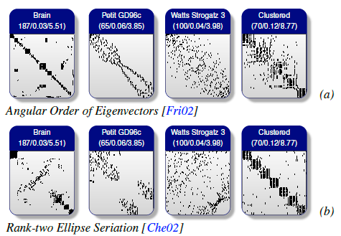
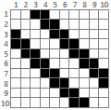
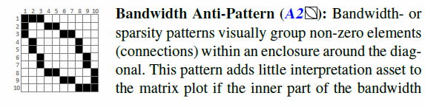
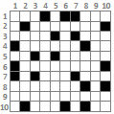
Robinsonian
Spectral Methods
Dimension Reduction
Heuristic Approaches
Matrix Reordering
Graph-Theoretic
Biclustering
Approaches
Interactive Approaches
Matrix Reordering

Slide 11
Robinsonian
Spectral Methods
Dimension Reduction
Heuristic Approaches
Matrix Reordering
Graph-Theoretic
Matrix Reordering
Biclustering
Approaches
Interactive Approaches

Slide 13
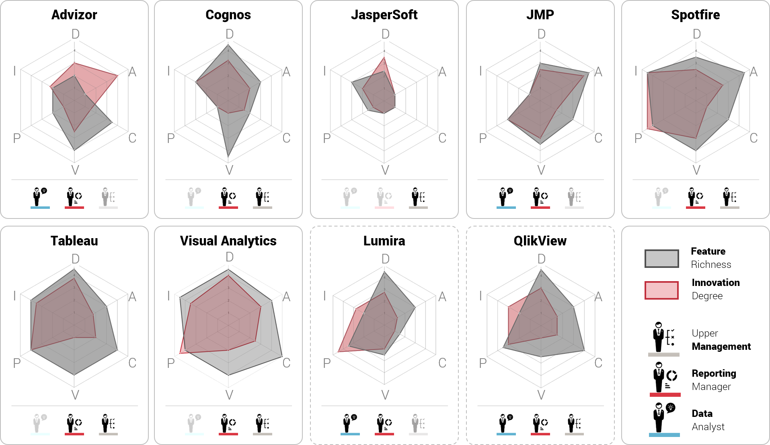
Commercial VA STAR

Slide 14
Commercial VA STAR

Slide 15
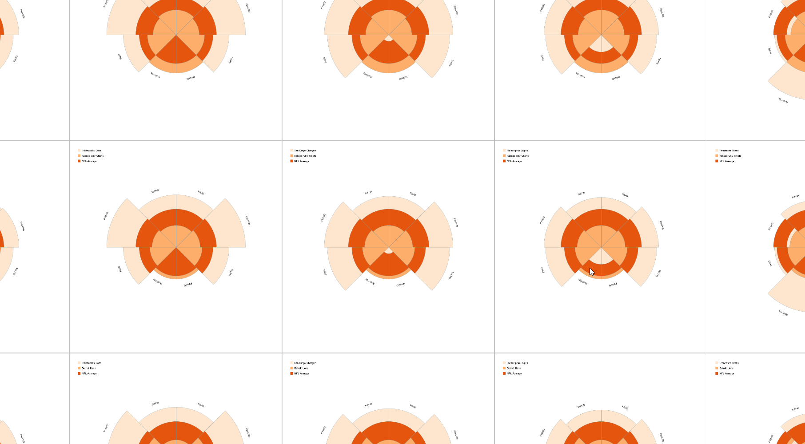

Glyph Matrices

Slide 16
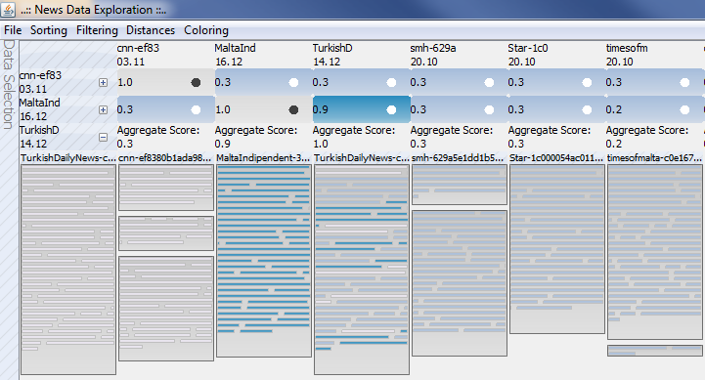
News Data

Slide 17
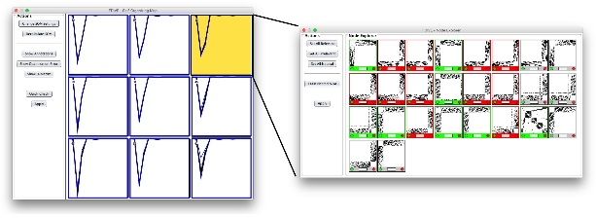
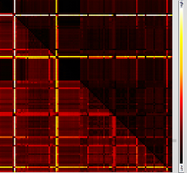
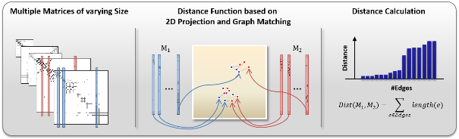
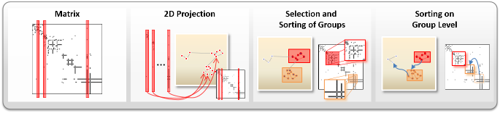
Data Exploration

Slide 18
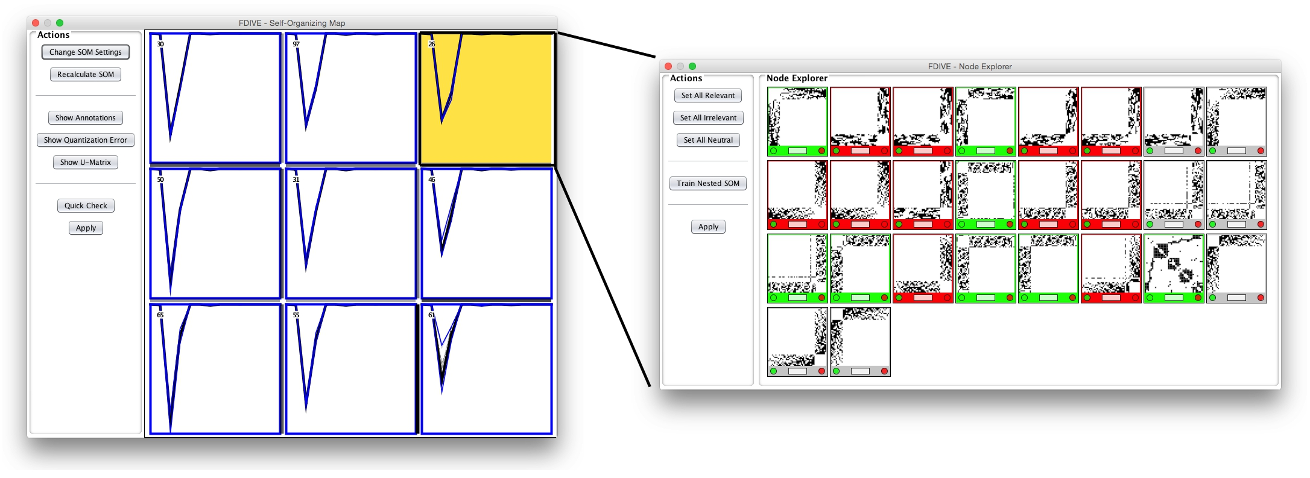
Data Exploration

Slide 19
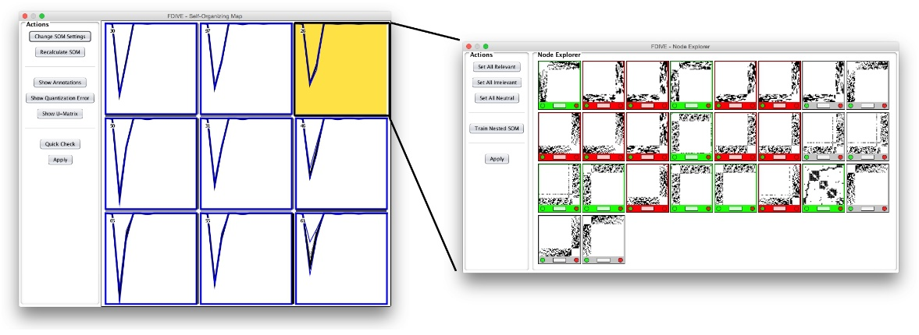
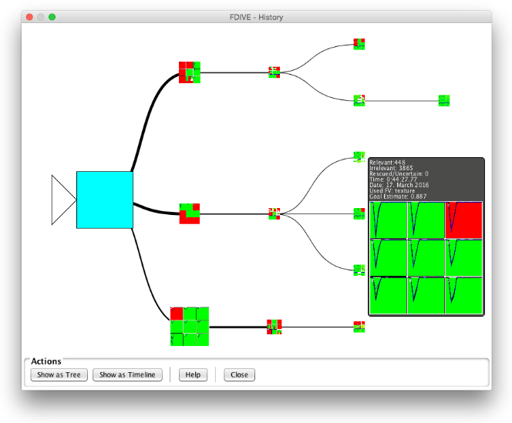
Data Exploration

